Slide 1

Career Readiness & Resume Intelligence Platform
An End-to-End Career Preparation System
Dasaradh D | PGDA 44, Imarticus Learning, Bangalore
Notes:
1

Slide 2

Problem Statement
Skills Blindspot
Resume Mismatch
Candidates don't know which skills they're missing or how to identify gaps for specific roles.
No clear understanding of how well their resume aligns with job descriptions.
Fragmented Tools
Existing solutions focus on either resumes or interviews—not both in one unified platform.
Notes:
2

Slide 3
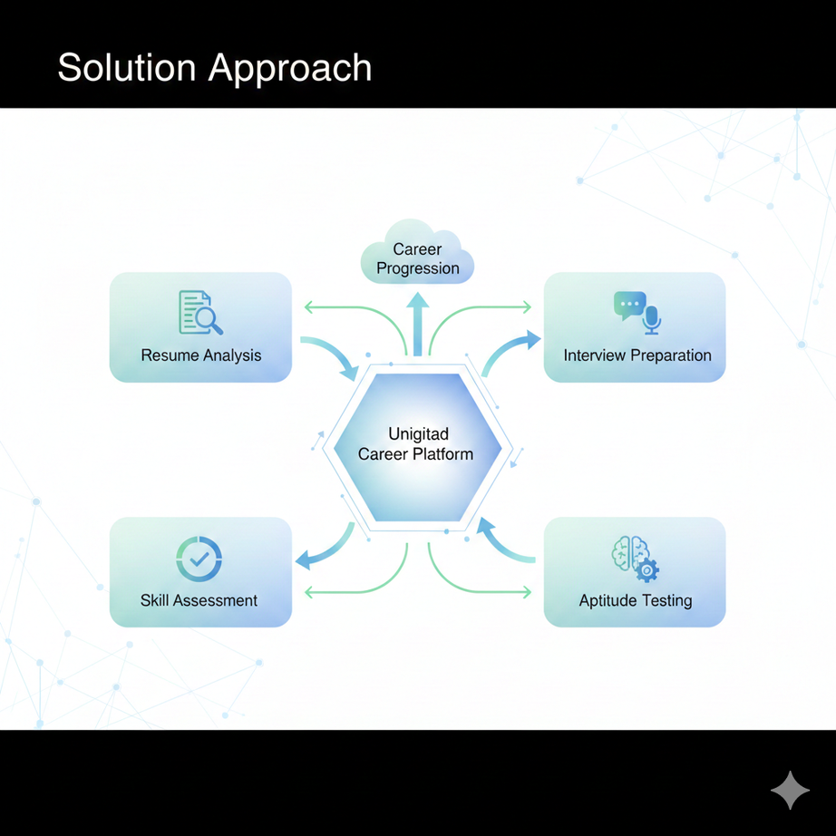
Solution Approach
A unified platform that transforms career preparation from guesswork to strategic action.
01
Resume Analysis
Analyze resumes against real job descriptions with intelligent matching algorithms.
02
Skill Assessment
Identify matched vs. missing skills with readiness scoring for target roles.
03
Interview Prep
Generate role-specific self-introductions and practice communication skills.
04
Aptitude Testing
Comprehensive assessment of vocabulary, speaking ability, and problem-solving.
Notes:
3

Slide 4
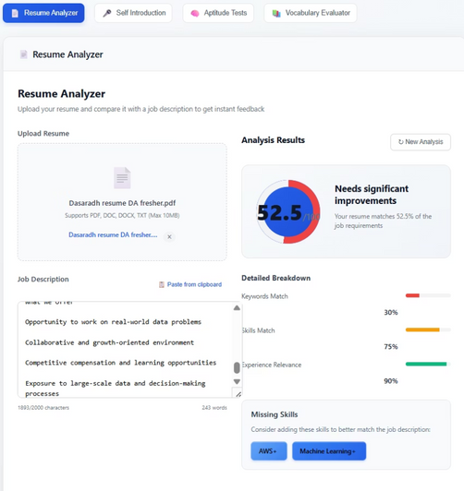
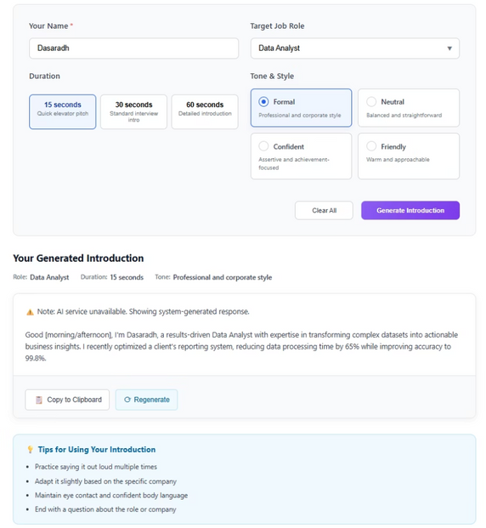
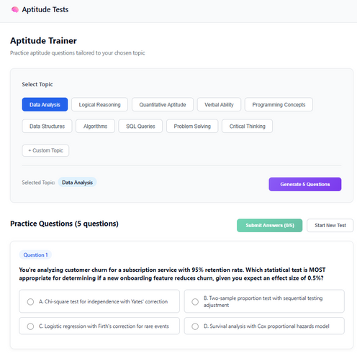
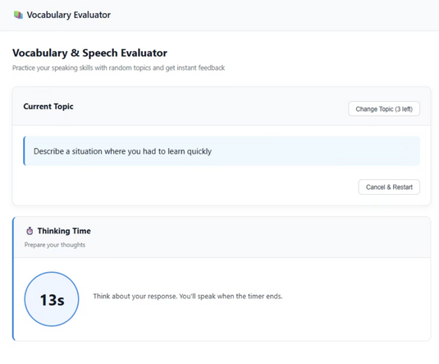

Platform Features in Action
Resume Analyzer
Self-Introduction Builder
JD-based scoring with detailed skill gap identification and actionable recommendatio
AI-powered tool creates tailored introductions for specific roles and industries.
Aptitude Practice
Speaking Evaluation
Dashboard
Notes:
4

Slide 5




Measurable Impact & Benefits
Objective Evaluation
Faster Feedback
Industry Alignment
Interview Confidence
Students receive immediate, detailed feedback to accelerate their preparation timeline.
Better matching with real job roles ensures candidates meet employer expectations.
Explainable resume scoring removes guesswork and provides clear, actionable insights.
Comprehensive preparation builds genuine readiness and self-assurance.
Notes:
5

Slide 6

Looking Ahead
Our Impact
Future Enhancements
The platform bridges the gap between education and employability, providing actionable, role-specific insights that transform career preparation.
Advanced AI-based scoring algorithms
Industry-specific skill models and benchmarks
Interactive interview simulation with real-time feedback
Cloud deployment for scalable access
Notes:
6

